Slide 1
Introduction to Machine Learning: CS 436/580L Clustering
Instructor: Arti Ramesh
Binghamton University

Slide 2
Machine Learning
Supervised Learning
Unsupervised Learning
Reinforcement Learning
Parametric
Non-parametric
Y Continuous
Y Discrete
Decision Trees
Greedy search; pruning
Gaussians
Learned in closed form
Probability of class | features
Learn P(Y), P(X|Y); apply Bayes
Learn P(Y|X) w/ gradient descent
Linear Functions
1. Learned in closed form
2. Using gradient descent
Non-probabilistic
Linear: perceptron gradient descent
Nonlinear: neural net: backprop
Support vector machines

Slide 3
Administrivia
Quiz next Tuesday, Dec 5th, 1:15 pm
HW 5 will be released later today

Slide 4
Outline
K-means & Agglomerative Clustering
Agglomerative Clustering
Expectation Maximization (EM)

Slide 5
Overview of Learning
Type of Supervision
(eg, Experience, Feedback)
 | Labeled Examples | Reward | Nothing
Discrete Function | Classification |  | Clustering
Continuous Function | Regression
Policy | Apprenticeship Learning | Reinforcement Learning
What is Being Learned?

Slide 6
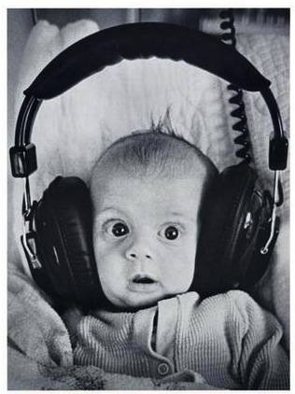
Clustering
Clustering systems:
Unsupervised learning
Requires data, but no labels
Detect patterns e.g. in
Group emails or search results
Customer shopping patterns
Program executions (intrusion detection)
Useful when don’t know what you’re looking for
But: often get gibberish

Slide 7
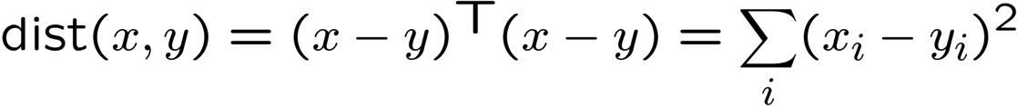
Clustering
Basic idea: group together similar instances
Example: 2D point patterns
What could “similar” mean?
One option: small (squared) Euclidean distance

Slide 8
K-Means: Algorithm
An iterative clustering algorithm
Pick K random points as cluster centers (means)
Alternate:
Assign data instances to closest cluster center
Change the cluster center to the average of its assigned points
Stop when no points’ assignments change

Slide 9
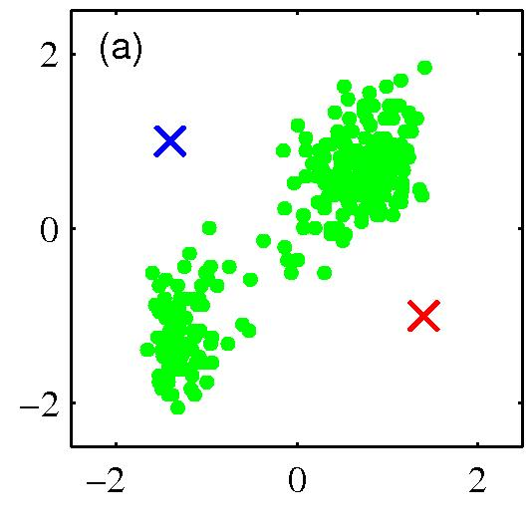
K-means clustering: Example
Pick K random points as cluster centers (means)

Slide 10
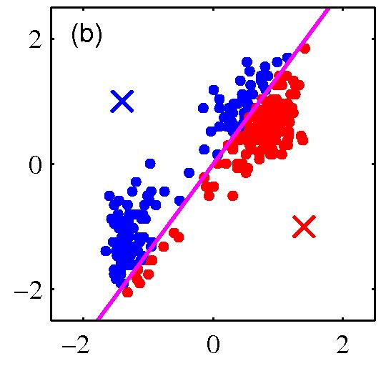
K-means clustering: Example
Iterative Step 1
Assign data instances to closest cluster center

Slide 11
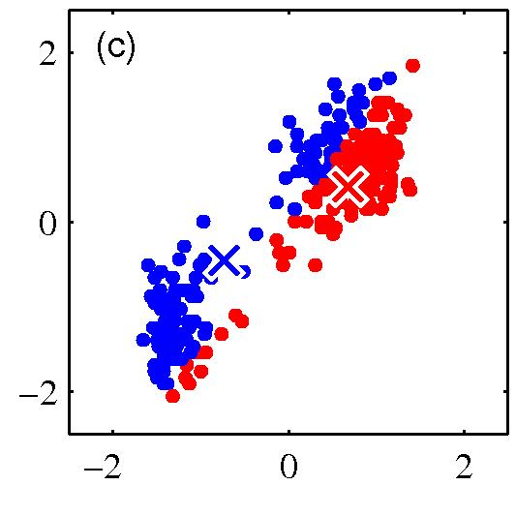
K-means clustering: Example
Iterative Step 2
Change the cluster center to the average of the assigned points

Slide 12
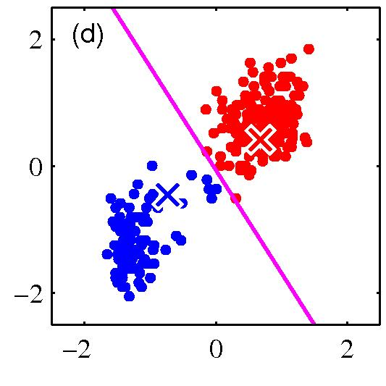
K-means clustering: Example
Repeat until convergence

Slide 13
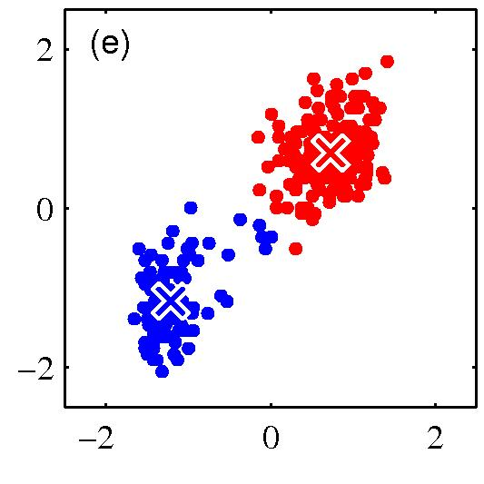
K-means clustering: Example

Slide 14
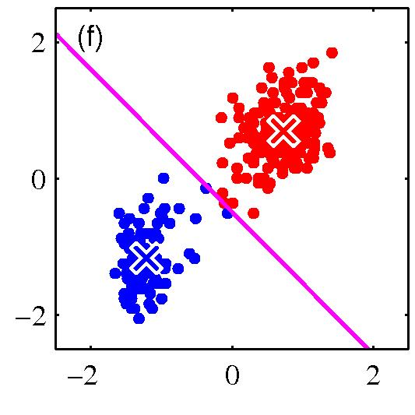
K-means clustering: Example

Slide 15
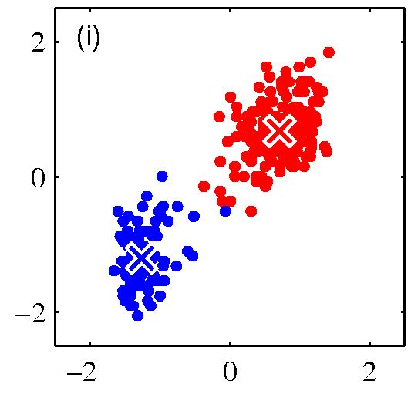
K-means clustering: Example

Slide 16
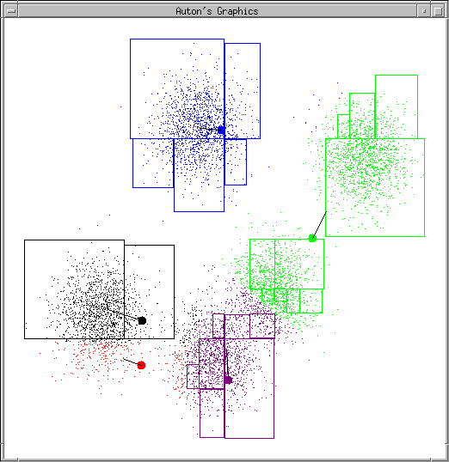
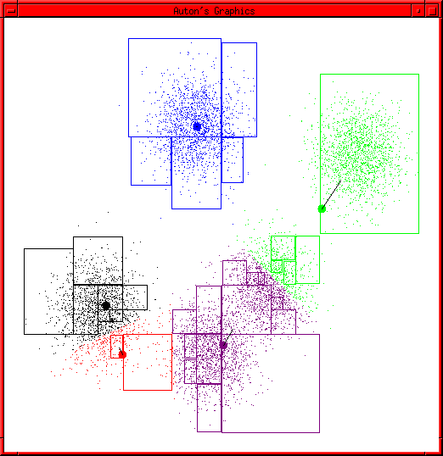
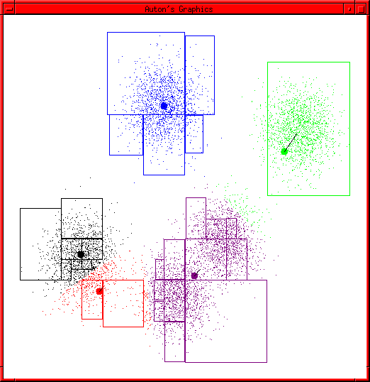
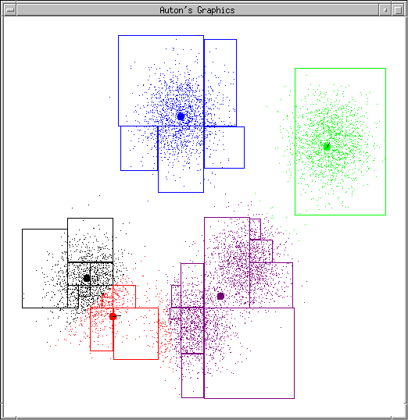
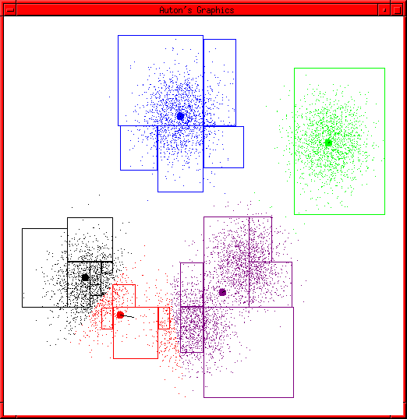
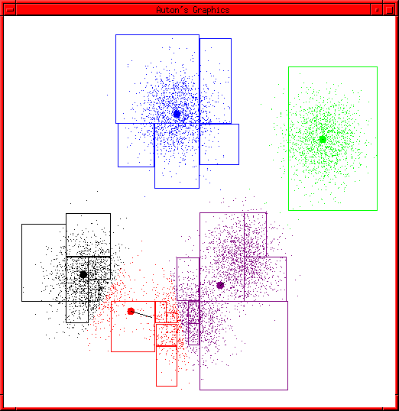
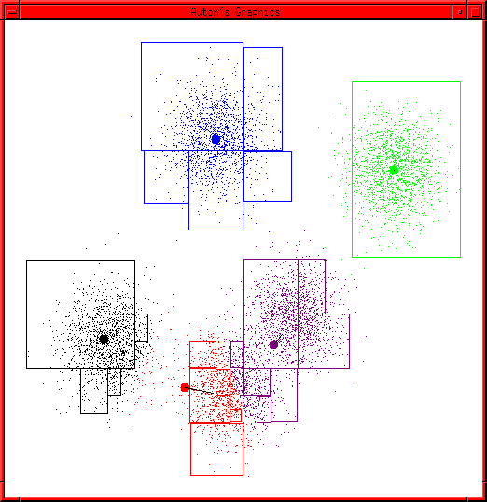
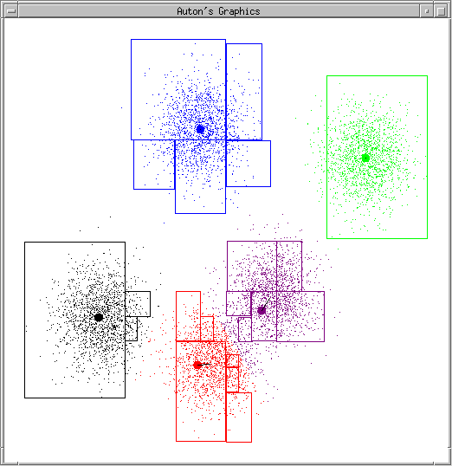
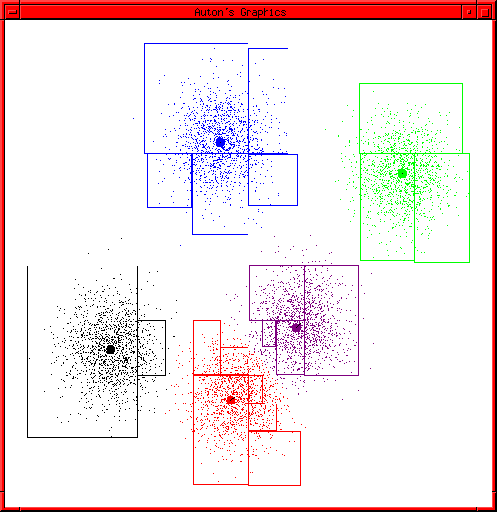
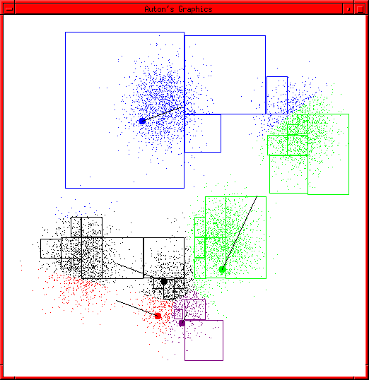
K-Means Example

Slide 17
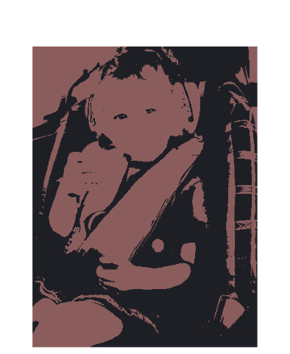

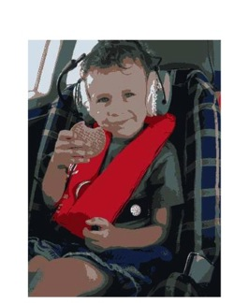
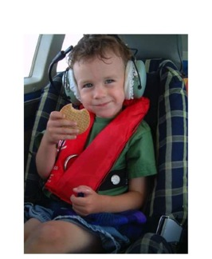
Example: K-Means for Segmentation
K=2
Original
Goal of Segmentation is to partition an image into regions each of which has reasonably homogenous visual appearance.

Slide 18
Example: K-Means for Segmentation
K=2
K=3
K=10
Original

Slide 19
Example: K-Means for Segmentation
K=2
K=3
K=10
Original
4%
8%
17%

Slide 20
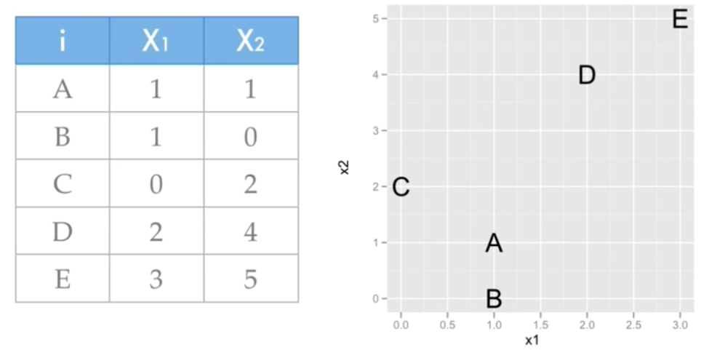
K-Means Example
Number of clusters: 2; A and C are initial cluster centers

Slide 21
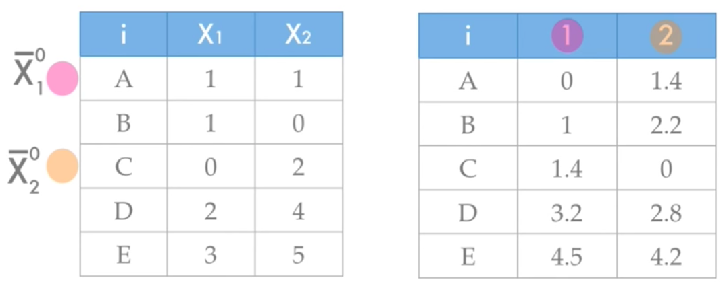
K-Means Example

Slide 22
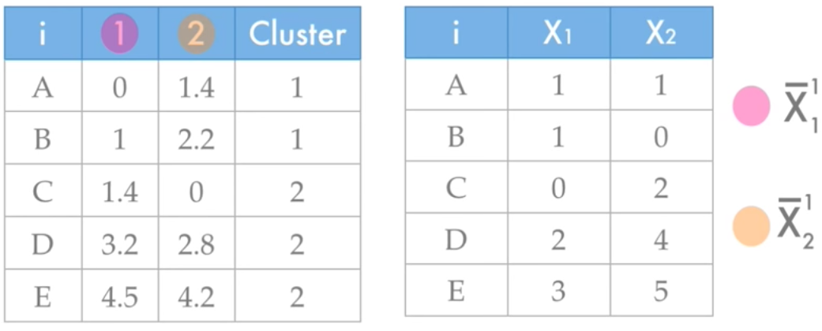
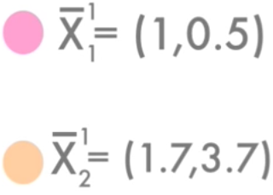
K-Means Example

Slide 23
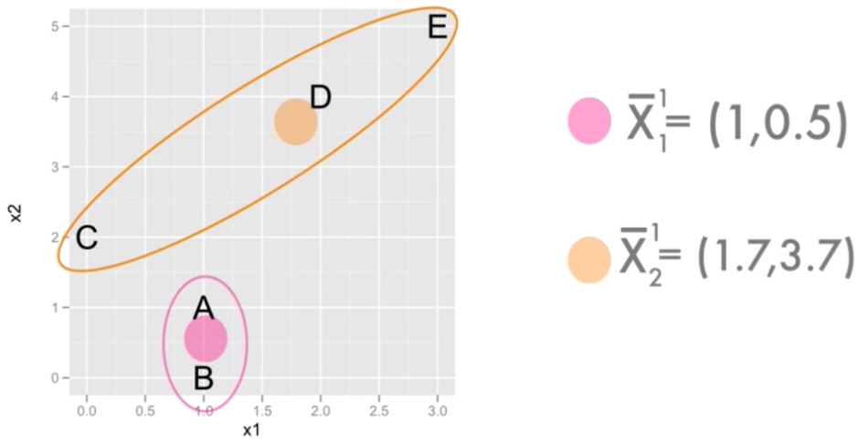
K-Means Example

Slide 24
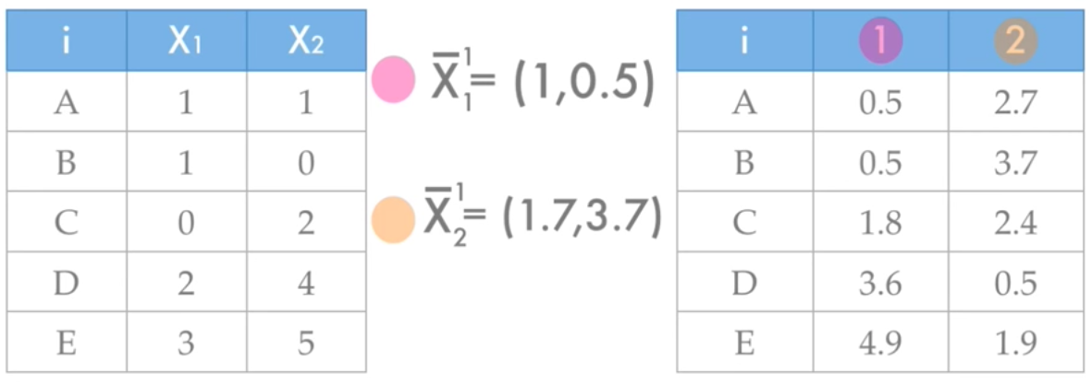
K-Means Example

Slide 25
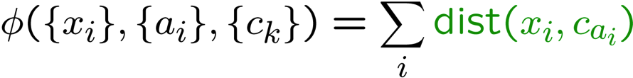
K-Means as Optimization
Consider the total distance to the means:
Two stages each iteration:
Update assignments: fix means c,
change assignments a
Update means: fix assignments a,
change means c
Co-ordinate Descent
Will it converge?
Yes!, if you can argue that each update can’t increase Φ
points
means
assignments

Slide 26
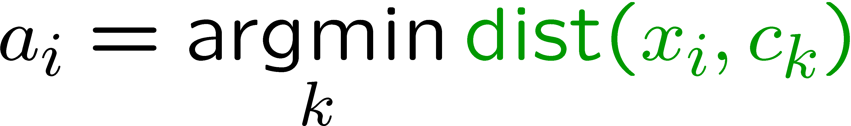
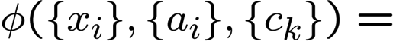
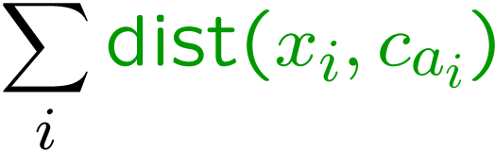
Phase I: Update Assignments
For each point, re-assign to closest mean:
Can only decrease total distance phi!

Slide 27
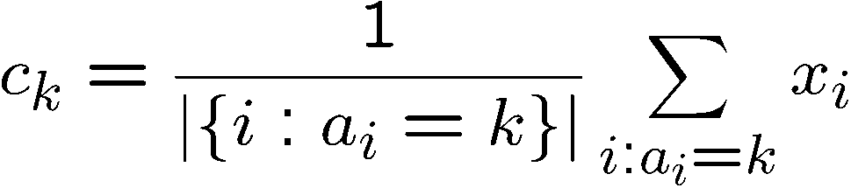
Phase II: Update Means
Move each mean to the average of its assigned points:
Also can only decrease total distance… (Why?)
Fun fact: the point y with minimum squared Euclidean distance to a set of points {x} is their mean

Slide 28
Initialization
K-means is non-deterministic
Requires initial means
It does matter what you pick!
What can go wrong?
Various schemes for preventing this kind of thing: variance-based split / merge, initialization heuristics

Slide 29
K-Means Getting Stuck
A local optimum:

Slide 30
Another Example
Y
X

Slide 31
Another Example
R
θ

Slide 32
K Means in Practice
Avoiding getting stuck
Random restarts
Take restart with best objective value
Better initialization
Kmeans++
1. Choose first centroid to be a random datapoint x
2. For each datapoint, compute distance to nearest centroid so far
3. Choose next center randomly among the datapoints, but weight the choice by the squared distance to the nearest centroid
4. Repeat steps 2 and 3 until all centroids are chosen

Slide 33
K-Means Questions
Will K-means converge?
To a global optimum?
Will it always find the true patterns in the data?
If the patterns are very very clear?
Runtime?
Do people ever use it?
How many clusters to pick?

Slide 34
Agglomerative Clustering
Agglomerative clustering:
First merge very similar instances
Incrementally build larger clusters out of smaller clusters
Algorithm:
Maintain a set of clusters
Initially, each instance in its own cluster
Repeat:
Pick the two closest clusters
Merge them into a new cluster
Stop when there’s only one cluster left
Produces not one clustering, but a family of clusterings represented by a dendrogram

Slide 35
Agglomerative Clustering
How should we define “closest” for clusters with multiple elements?

Slide 36
Agglomerative Clustering
How should we define “closest” for clusters with multiple elements?
Many options:
Closest pair (single-link clustering)
Farthest pair (complete-link clustering)
Average of all pairs
Ward’s method
(min variance, like k-means)
Find pair of clusters that leads to minimum increase in total within cluster variance after merging
Notes:
Ward’s method: optimal value of an objective function. Error sum of squares. At each step, find the pair of clusters that leads to minimum increase in total within-cluster variance after merging.

Slide 37
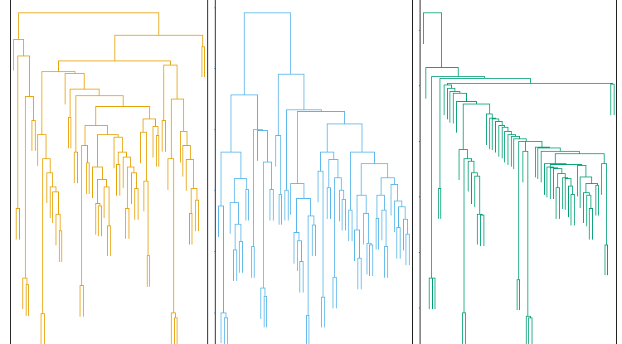
Clustering Behavior
Average
Farthest
Nearest
Mouse tumor data from [Hastie]

Slide 38
Agglomerative Clustering Questions
Will agglomerative clustering converge?
To a global optimum?
Will it always find the true patterns in the data?
Do people ever use it?
How many clusters to pick?

Slide 39
Mixture Models
Assume data is generated using the following procedure:
Pick one of the k components according to P(z_{k}). This generates a hidden class label z_{k}.
Generate a data point by sampling from P(x | z_{k}).
Results in probability distribution of a single point
Where, P(x | z_{k}) is any distribution (gaussian, poisson, exponential, etc)

Slide 40
Gaussian Mixture Model
Most common mixture model is a Gaussian Mixture Model:

Slide 41
Clustering with GMMs
Want to find P(z_{k}) and P(x | z_{k}) to learn the underlying model and find clusters
Want to compute P(z_{k} | x) for each point in training set to assign them to clusters
Can we use maximum likelihood to infer both model and assignments?
Requires solving non-linear system of equations
No analytic solution

Slide 42
Problem: Missing labels
If we knew the assignments, we could learn model parameters easily.
Parameter estimation!
If we knew the model parameters, we could estimate the most likely assignments easily.
Classification!

Slide 43
Solution: The EM Algorithm
We deal with missing parameters and labels by alternating between two steps:
Expectation:
Fix model and estimate the missing labels
Maximization:
Fix missing labels (usually a distribution of missing labels) and find the model that maximizes the expected log-likelihood of the data

Slide 44
EM: Soft Clustering
Clustering typically assumes that each instance is given a “hard” assignment to exactly one cluster.
Does not allow uncertainty in class membership or for an instance to belong to more than one cluster.
Problematic because data points that lie roughly midway between cluster centers are assigned to one cluster
Soft clustering gives probabilities that an instance belongs to each of a set of clusters.

Slide 45
Probabilistic Clustering
Try a probabilistic model!
allows overlaps, clusters of different size, etc.
Can tell a generative story for data
P(X|Y) P(Y)
Challenge: we need to estimate model parameters without labeled Ys
Y | X₁ | X₂
?? | 0.1 | 2.1
?? | 0.5 | -1.1
?? | 0.0 | 3.0
?? | -0.1 | -2.0
?? | 0.2 | 1.5
… | … | …

Slide 46
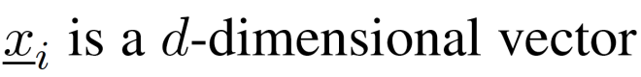
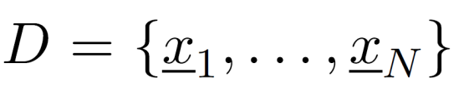
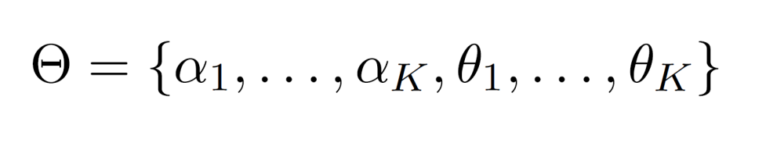
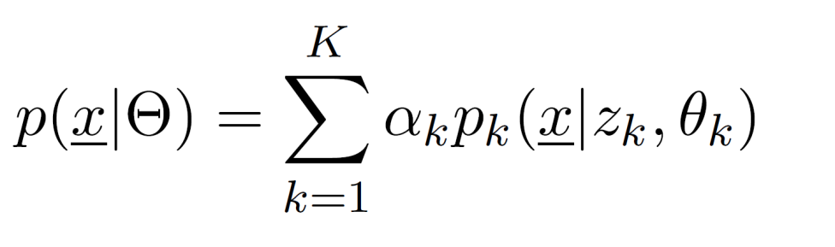
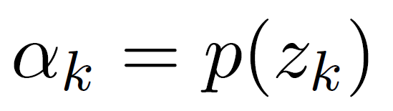
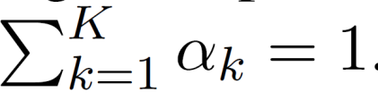
Finite Mixture Models
Given a dataset:
Mixture model:
Mixture Weights.

Slide 47
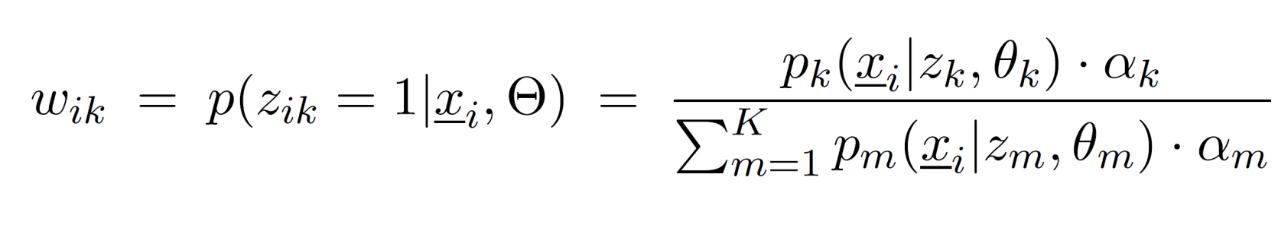
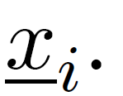
Finite Mixture Model: Probabilistic View
The membership weight express our uncertainty about which of the “K” components generated the vector

Slide 48
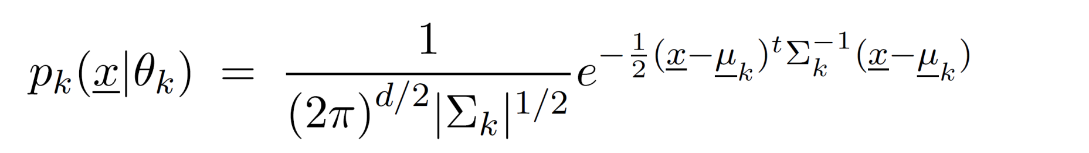
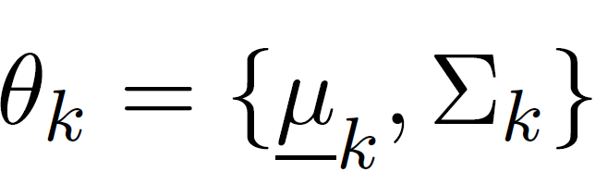
Gaussian Mixture Models (GMMs)
We can define a GMM by making each “k-th” component a Gaussian density with parameters:
Question: How to learn these parameters from data?

Slide 49
EM algorithm: Key Idea
Start with random parameters
Find a class for each example (E-step)
Since we are using probabilistic classification, each example will be given a vector of probabilities
Now we have a supervised learning problem. Estimate the parameters of the model using the maximum likelihood method (M-step)
Iterate between the E-step and M-step until convergence

Slide 50
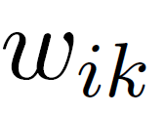
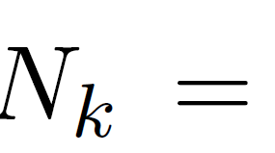
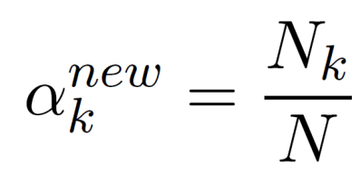
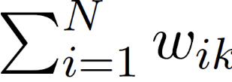
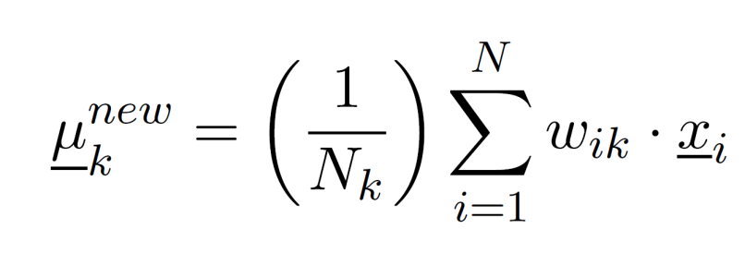
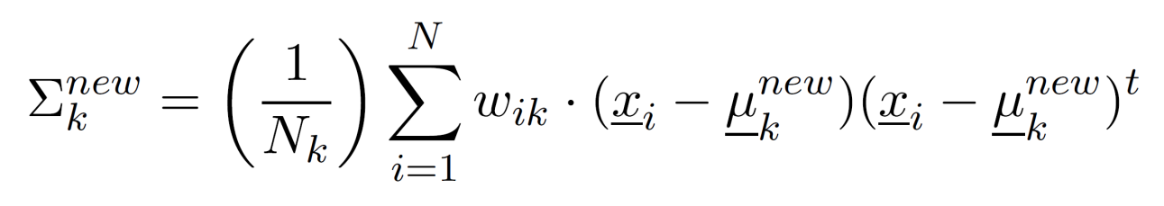
EM: Two Easy Steps
E-step: (Yields a N x K matrix)
Compute for all data points indexed by “i” and all mixture components indexed by “k.”
M-step:
Use the membership weights and data to compute the new parameters

Slide 51

Gaussian Mixture Example: Start

Slide 52

After first iteration

Slide 53

After 2nd iteration

Slide 54

After 3rd iteration

Slide 55

After 4th iteration

Slide 56

After 5th iteration

Slide 57

After 6th iteration

Slide 58

After 20th iteration

Slide 59
Properties of EM
EM converges to a local minima
This is because each iteration improves the log-likelihood
Proof same as K-means
E-step can never decrease likelihood
M-step can never decrease likelihood
If we make hard assignments instead of soft ones. Algorithm is equivalent to K-means!

Slide 60
What you should know
K-means for clustering:
algorithm
converges because it’s coordinate ascent
Know what agglomerative clustering is
EM for mixture of Gaussians:
Remember, E.M. can get stuck in local minima,
And empirically it DOES!

Slide 61
EM Example

Slide 62
EM Example

Slide 63
EM Example

Slide 64
EM Example

Slide 65
EM: The Intuition
Notes:
First we use 0.6 and 0.5 to calculate the probability of the sequence of heads and tails using both the coins. For coin 1, (0.6)^5 (0.4)^5 and (0.5)^5 (0.5)^5. We then normalize these values by (0.6)^5 (0.4)^5 /[(0.6)^5 (0.4)^5 + (0.5)^5 (0.5)^5] and (0.5)^5 (0.5)^5/[(0.6)^5 (0.4)^5 + (0.5)^5 (0.5)^5] and get 0.45 and 0.55. Then, we calculate the number of heads and tails again using 0.45 * 5 (heads) and 0.45 * 5 (tails) for coin 1 and 0.55 * 5 (heads) and 0.55 * 5 (tails) for coin 2. We repeat the same for all the sequences to get the number of heads and tails and then we calculate the new probabilities of the coins by number of heads/number of heads + tails, for both coins. We repeat all the above steps until convergence.

Slide 66
EM: The Math

Slide 67
EM: The Math

Slide 68
EM: Computing the Expectation

Slide 69
EM: Expectation Step

Slide 70
EM: Expectation Step

Slide 71
EM: Expectation Step

Slide 72
EM: Maximization Step

Slide 73
EM: Maximization Step

Slide 74
PrACTICAL ADVICE: How to use machine learning for solving real world problems!
Instructor: Arti Ramesh

Slide 75
Steps in Supervised Learning
Determine the representation for “x,f(x)” and determine what “x” to use
Feature Engineering
Gather a training set (not all data is kosher)
Data Cleaning
Select a suitable evaluation method
Find a suitable learning algorithm among a plethora of available choices
Notes:
Given a real-world “Big data application”, how do you perform supervised learning. The key steps are: (1)

Slide 76
Feature Engineering is the Key
Most effort in ML projects is constructing features
Black art: Intuition, creativity required
Understand properties of the task at hand
How the features interact with or limit the algorithm you are using.
ML is an iterative process
Try different types of features, experiment with each and then decide which feature set/algorithm combination to use
Notes:
At the end of the day, some machine learning projects succeed and some fail. What makes the difference? Easily the most important factor is the features used.

Slide 77
What features will you use?
Examples
Spam Filtering
Mapping images to names
Feature Combination
Linear models cannot handle some dependencies between features (e.g. XOR)
Feature combinations might work better.
Quick growth of the number of features.

Slide 78
Evaluation
Accuracy
Fraction of the examples that are correctly classified by the learner
Precision, Recall and F-score (Next slide)
Squared error (Regression problems)
Likelihood
Posterior probability
Cost / Utility
Etc.

Slide 79

Precision, Recall and F-1 score
Precision (P) = ; Recall (R)=
F1-score =
Harmonic mean of precision and recall
 | Actual=True | Actual=False
Predicted=True | tp (correct result) | fp (unexpected result)
Predicted=False | fn (missing result) | tn (correct absence of result)
Notes:
P = number of correct results divided by all returned results
R = number of correct results divided by the number of results that should have been returned.

Slide 80
What algorithms (Classifiers/learners) to use
Naïve Bayes
Logistic Regression
Linear SVMs
Decision Trees
Neural Networks
Support Vector Machines
K-nearest neighbors (Non-parametric)
Bagging (Meta); Boosting (Meta)
Linear classifiers
Non-linear
Weka Software

Slide 81


Classifiers: Bias versus Variance
High Bias, low variance
Low Bias, High variance
Linear Classifier
Naïve Bayes
Logistic Regression
Perceptron
Non-Linear Classifier
Support vector machine (Kernels)
Neural networks
Decision Trees
Simpler
Complex
Notes:
Bias is a learner’s tendency to consistently learn the same wrong thing. Variance is the tendency to learn random things irrespective of the real signal.

Slide 82
Learning = Representation + Evaluation + Optimization
Thousands of learning algorithms
Combinations of just three elements
Representation | Evaluation | Optimization
Instances | Accuracy | Greedy search
Hyperplanes | Precision/Recall | Branch & bound
Decision trees | Squared error | Gradient descent
Sets of rules | Likelihood | Quasi-Newton
Neural networks | Posterior prob. | Linear progr.
Graphical models | Margin | Quadratic progr.
Etc. | Etc. | Etc.

Slide 83
It’s Generalization that Counts
Divide data into training, test and hold-out or validation set
Algorithm must work on test examples never seen before
Training examples can just be memorized
Don’t tune parameters on test data
Use cross-validation
Training
Data
Hold-Out
Data
Test
Data

Slide 84
K-Fold Cross Validation
Choose a suitable K (usually 10)
Test
Train on (k
-
1) splits
k-fold

Slide 85
Data Alone Is Not Enough
Classes of unseen examples are arbitrary
So learner must make assumptions
“No free lunch” theorems
Luckily, real world is not random
Induction is knowledge lever

Slide 86
Overfitting Has Many Faces
Classifier A is better than B on the training set but the reverse is true on the test set!!
The biggest problem in machine learning
Bias and variance (Simple vs. Complex)
Can learn a simpler linear function vs. can learn any function
Less powerful learners can be better
Solutions: Cross-validation; Regularization
Notes:
Basically, what it means is that knowledge and data we have are not sufficient to completely determine the correct classifier and we run the risk of just hallucinating a classifier (or parts of it) that is not grounded in reality, and is simply encoding random quirks in the data.
Bias is a learner’s tendency to consistently learn the same wrong thing. Variance is the tendency to learn random things irrespective of the real signal.
The most popular one is adding a regularization term to the evaluation function. This can, for example, penalize classifiers with more structure, thereby favoring smaller ones with less room to overfit. Another option is to perform a statistical significance test like chi-square before adding new structure, to decide whether the distribution of the class really is different with and without this structure. These techniques are particularly useful when data is very scarce. Nevertheless, you should be skeptical of claims that a particular technique “solves” the overfitting problem. It’s easy to avoid overfitting (variance) by falling into the opposite error of underfitting (bias). Simultaneously avoiding both requires learning a perfect classifier, and short of knowing it in advance there is no single technique that will always do best (no free lunch).

Slide 87
Intuition Fails In High Dimensions
Curse of dimensionality
Sparseness worsens exponentially with number of features
Irrelevant features ruin similarity
In high dimensions all examples look alike
3D intuitions do not apply in high dimensions
Blessing of non-uniformity
Notes:
Generalizing correctly becomes exponentially harder as the dimensionality (number of features) of the examples grows, because a fixed-size training set covers a dwindling fraction of the input space.
Even with a moderate dimension of 100 and a huge training set of a trillion examples, the latter covers only a fraction of about 10⁻¹⁸ of the input space. This is what makes machine learning both necessary and hard.

Slide 88
Theoretical Guarantees Are Not What They Seem
Bounds on number of examples needed to ensure good generalization
Extremely loose
Low training error ≠> Low test error
Asymptotic guarantees may be misleading
Theory is useful for algorithm design, not evaluation

Slide 89
More Data Beats a Cleverer Algorithm
Easiest way to improve: More data
Then
Data is bottleneck
Now:
Scalability is bottleneck
ML algorithms more similar than they appear
Clever algorithms require more effort but can pay off in the end
Biggest bottleneck is human time

Slide 90
Learn Many Models, Not Just One
Three stages of machine learning
Try variations of one algorithm, chose one
Try variations of many algorithms, choose one
Combine many algorithms, variations
Ensemble techniques
Bagging
Boosting
Stacking
Etc.

Slide 91
Simplicity Does Not Imply Accuracy
Occam’s razor
Common misconception: Simpler classifiers are more accurate
Contradicts “no free lunch” theorems
Counterexamples: ensembles, SVMs, etc.
Can make preferred hypotheses shorter

Slide 92
Representable Does Not Imply Learnable
Standard claim: “My language can represent/approximate any function”
No excuse for ignoring others
Causes of non-learnability
Not enough data
Not enough components
Not enough search
Some representations exponentially more compact than others

Slide 93
Advanced topics

Slide 94
Supervised Learning and its Generalizations
Supervised Learning
Desired output is simple. (e.g., purchase an item or not; the person has the disease or not; etc.)
Structured Prediction: is a Generalization
Desired output is complex.

Slide 95
Structured Prediction: Examples
Parsing: given an input sequence, build a tree whose leaves are the elements in the sequence and whose structure obeys some grammar.
Collective classification: given a graph defined by a set of vertices and edges, produce a labeling of the vertices.
Labeling web pages given link information

Slide 96
Models and Algorithms for Structured Prediction
Probabilistic Graphical Models
Compact representation of joint distribution
Principled way of dealing with uncertainty
Take advantage of conditional independence
Markov logic and statistical relational models
Model both relational structure and uncertainty
One example related with another example
Considerable machine learning expertise required here! (not yet a blackbox)

